Slide 1



Module 1
Getting Started
Instructor: Luca Iandoli, PhD
luca.iandoli@stevens.edu
Stevens Institute of Technology School of Systems and Enterprises Castle Point on Hudson
Hoboken, NJ 07030

Slide 2
Today’s agenda
Introductions
Course’s objectives & content
Assignments & grading
Basic concepts of Organizational behavior
Introduction to project #1: defining an organizational accident

Slide 3
Today’s agenda
Introductions: one special thing

Slide 4
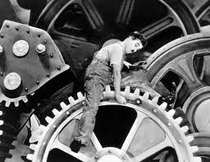
Course Objectives
This course introduces the attributes associated with the design and management of the human activity system that is responsible for operating an organization
It is built on a fundamental that the successful development of an organizational system is directly contingent on the human system.

Slide 5

Course Objectives
Provide a background on
Organizational Behavior
Apply OB concepts and theories to corporate and business management through methodologies for organizational analysis
Analyze organizations with a special focus on the management of singularities and crises, including accidents and creation of breakthrough innovations

Slide 6
Course Contents
Organizational factors
(structure, culture, change)
Class 2 & 13
Organizational success
Productivity & satisfaction of individuals
Class 10-12
Class 3-9
and groups
Individual factors
(learning, personality,
motivation, …)
Group factors
(leadership, communication,
decision making, teamwork, politics & conflict …)
(adapted from Hitt, Colella and Miller., 2009)

Slide 7
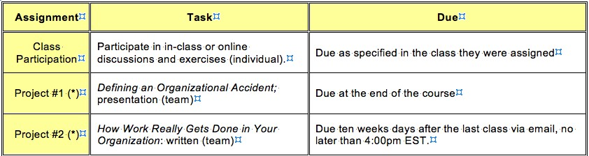
Assignments
Team assignments
Form teams ASAP (3 members + 1 team leader)

Slide 8
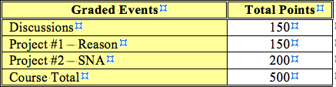
Grading

Slide 9
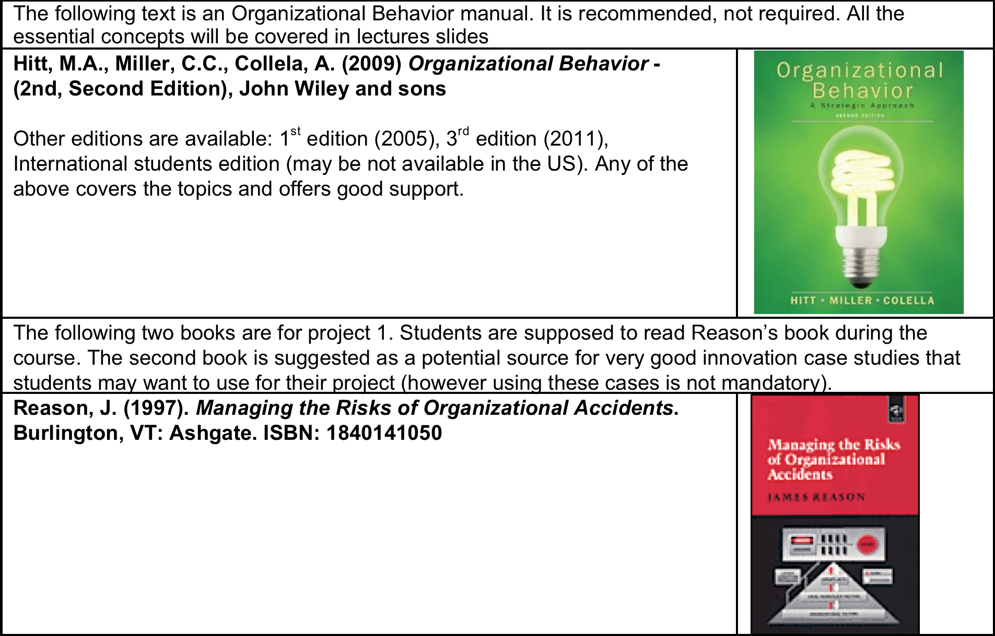
Textbooks

Slide 10
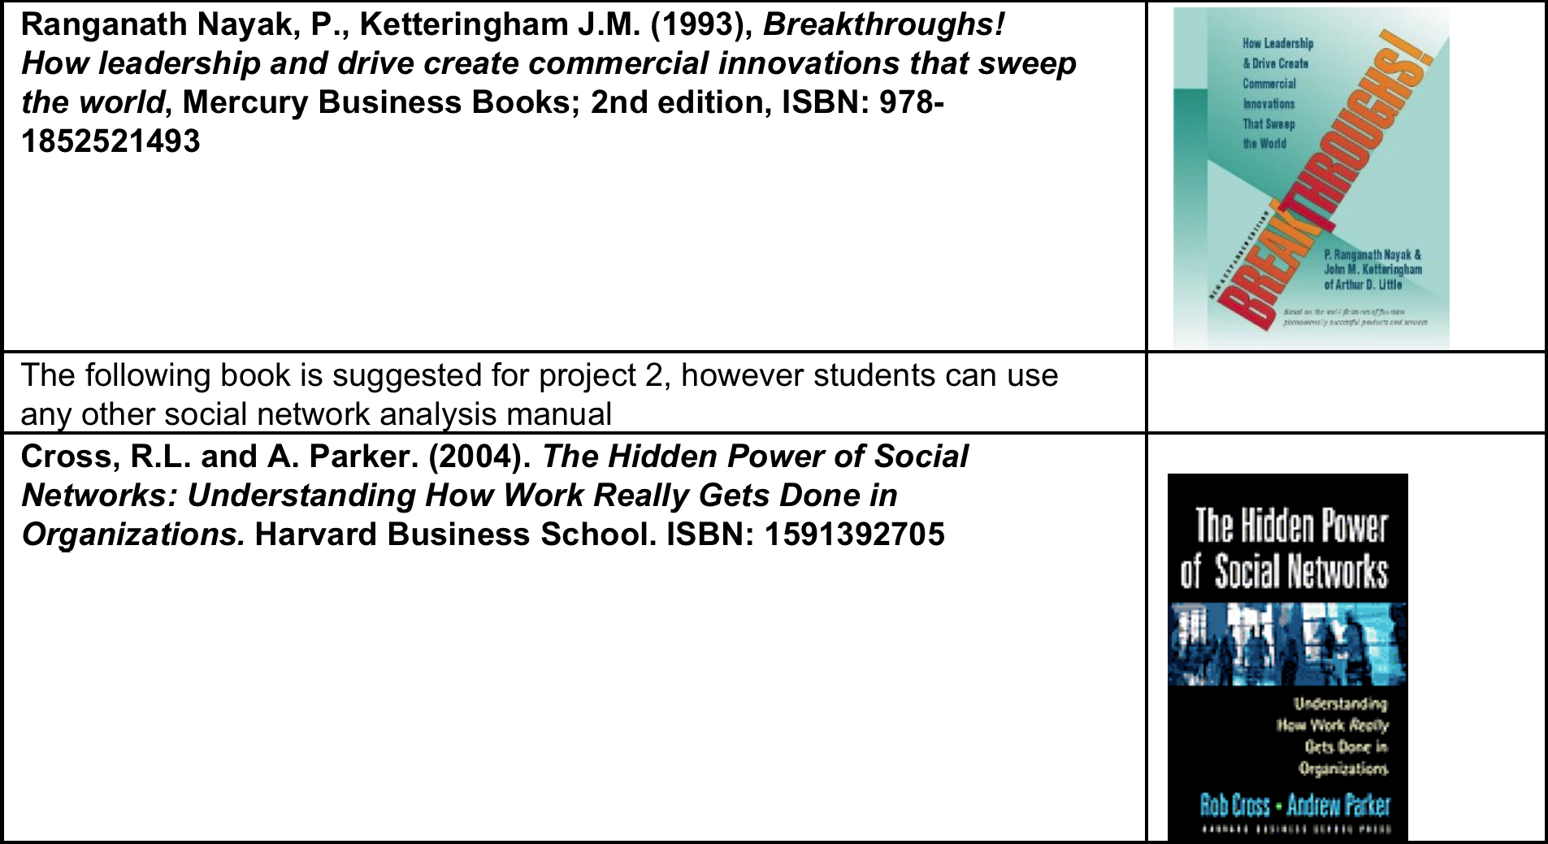
Textbooks

Slide 11
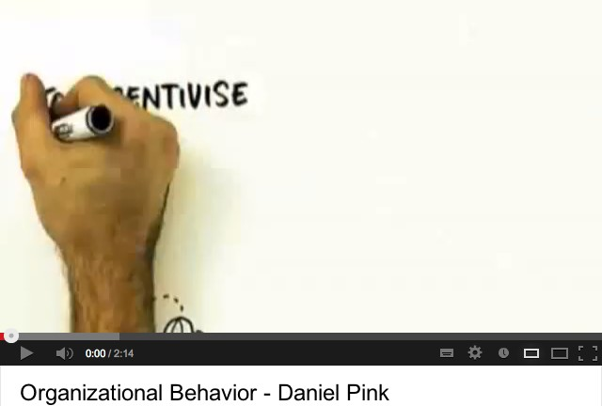
Basic concepts of Organizational
behavior
Organizational Behavior is…

Slide 12
Basic concepts of Organizational
behavior
Organizational Behavior science is about investigating how individuals and groups behave in organizations
The purpose is applying this science to improve organizational design & effectiveness
Management of OB is ultimately about implementing actions focused on acquiring, developing and applying the knowledge and skills of people (associates)

Slide 13
In class discussion
What is an organization?
Propose a metaphor/image
Try a definition

Slide 14
In class discussion: what is an
organization?
The ways in which the division of labor is broken down into distinct tasks and the coordination of these tasks (Mintzberg, 1979).
The number of roles that single employees have to play and the relationships between them whose coordination will permit the achievement of company goals (Aldrich, 1979).
The rational coordination of activities of a certain number of people in order to reach a common and explicit goal through the division of labor and through the creation of a hierarchy (Schein, 1985).
A social entity guided by objectives and planned as a system of activities that are deliberately structured and coordinated to interact with the external environment (Daft, 2001).

Slide 15
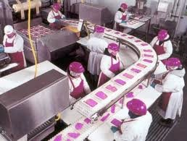
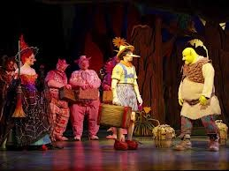
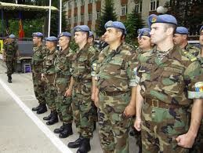
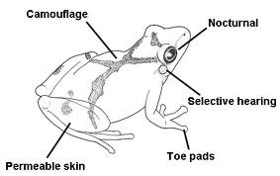
In class discussion: what is an
organization?
Assembly line
The ways in which the division of labor is broke distinct tasks and the coordination of these task
n down into
s (Mintzberg,
1979).
drama
The number of roles that relationships between th achievement of company
single employees
em whose coordi goals (Aldrich, 19
have to play and the nation will permit the 79).
Army
e
The rational coordination of activities of a certain number of people in order to reach a common and explicit
goal through th
archy (Schein,
s a system of
division of labor and through the creation of a hier
1985).
A social activities interact
Organism
entity guided by o
that are deliberat with the external e
bjectives and planned a
ely structured and coordinated to
nvironment (Daft, 2001).

Slide 16
In class discussion: what is an
organization?
Your textbook definition:
A collection of individuals forming a coordinated system of specialized activities for the purpose of achieving certain goals over an extended period of time

Slide 17
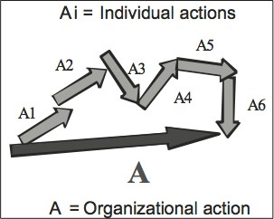
In class discussion: what is an
organization?
What do these definitions have in common?
An organization is a system for the composition and integration of individual actions into collective action
… in a way that collective action has continuity and regularity

Slide 18
In class discussion: what is an
organization?
How regularity and continuity of collective action is achieved in organizations? Can you think of some examples?

Slide 19
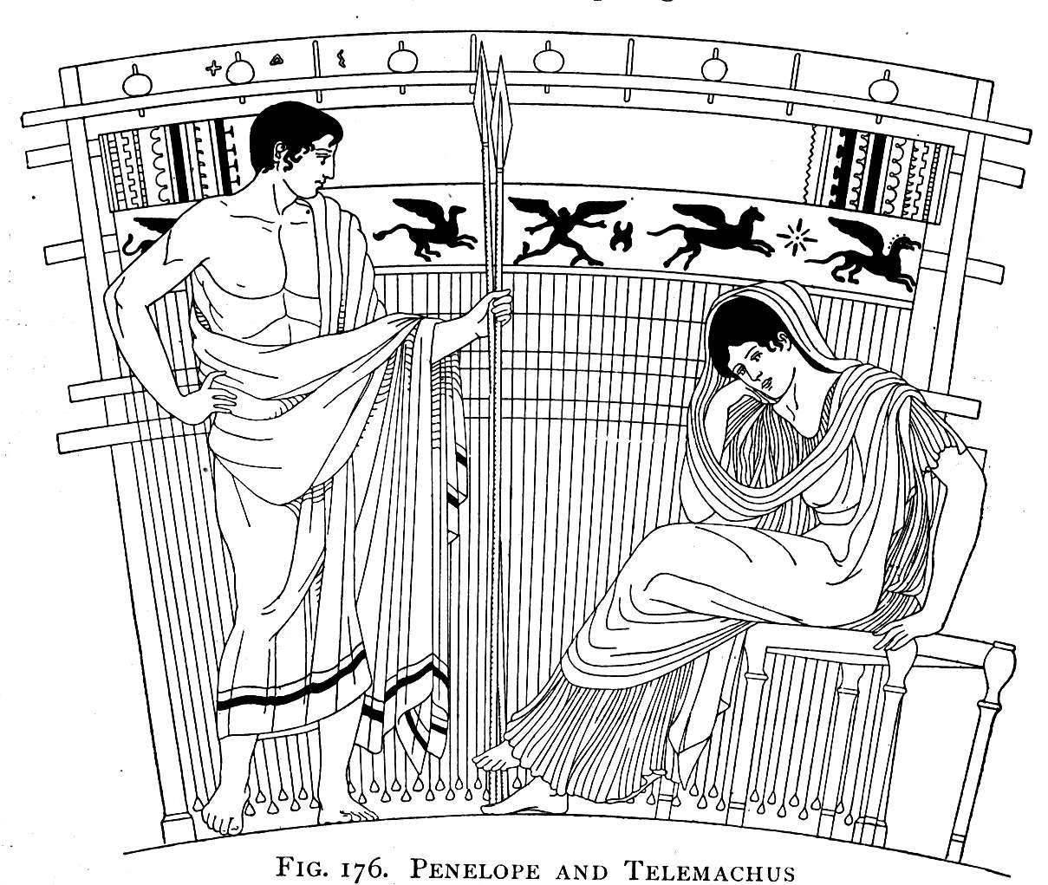
In class discussion: what is an
organization?
Stability and regularity of Collective action should not be taken for granted. It needs maintenance
What is maintenance all about?
Reinforcement!

Slide 20
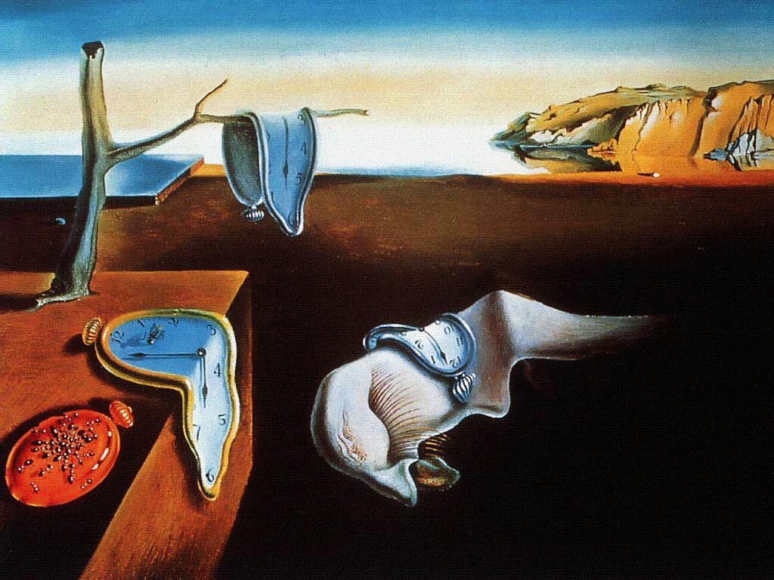
In class discussion: what is an
organization?
An organization does not exist, it persists

Slide 21
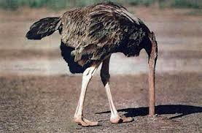


In class discussion: what is an
organization?
The organizing paradox: why change is so difficult in organizations?
Because reinforcement implies resistance
to change …BY DESIGN!

Slide 22

In class discussion: what is an
organization?
SHI(F)T HAPPENS!

Slide 23
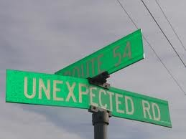
Project #1 Overview Defining an
Organizational Accident
When SHI(F)T HAPPENS,
persistence is seriously questioned
So, it is interesting to analyze how organizations manage to react (or fail to) to the unexpected

Slide 24
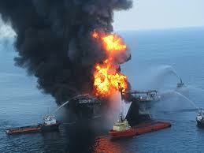

Project #1 Overview Defining an
Organizational Accident
Two perspectives to analyze organizational accidents
What do they have in common?
Disaster!
Accidental Innovation!

Slide 25

Project #1 Overview Defining an
Organizational Accident
In the status quo perspective Innovation is always wrong!

Slide 26
Project #1 Overview Defining an
Organizational Accident
Use OB theories to perform a case study analysis of an organizational accident of your choice (disaster or breakthrough)
Use an engineering management standpoint (e.g. technology-based, engineering case, project management failure, etc.)

Slide 27
Project #1 Overview Defining an
Organizational Accident
Your team will be responsible for giving two presentations:
a first max 15 minutes presentation due during the course to introduce the case to the class through an appropriate narrative. The narrative must be followed by 2-3 questions/issues aimed at stimulating a discussion in the class after the presentation
a 20 minute final presentation showing your analysis of the case using Reason’s theories AND at least THREE principals or theories presented in class. This analysis should focus on:
What were the organizational issues with the case and how do theories explain the problems?
What can we learn from studying this case that can be applied to other similar projects?

Slide 28
Project #1 Overview Defining an
Organizational Accident
Outline for the first presentation:
The headings below represent generic headers. They can be changed to reflect the content of your presentation. The basic sections that should be included are:
Title Slide
Title/Team Members/Team Name/Date
Case narrative
References
Questions for discussion
Outline why you think this case is interesting and why you selected it.
Point out one or two issues that you consider exploring further in your analysis and ask the class for feedback and suggestions about additional analyses, alternative perspectives, materials and references including “similar” cases, etc.

Slide 29
Project #1 Overview Defining an
Organizational Accident
Schedule
Team 1, September 23
Team 2, September 30
Team 3, October 7
Team 4, October 14
Team 5, November 4
Team 6, November 11
After each presentation there will be an in class discussion, discussions will be considered for grading

Slide 30
For Next class
Teams must be formed and communicated to the instructor by next week. Please make an effort to mingle and create international teams
Read the DEC case (materials on moodle)
– In class discussion on Organizational culture and failure of a leading company (will contribute to grading)

